Slide 1
Polymerase Chain Reaction (PCR)

Slide 2
PCR Polymerase chain reaction (PCR) is a technique used in molecular biology to amplify a single copy or a few copies of a segment of DNA across several orders of magnitude, generating thousands to millions of copies of a particular DNA sequence.
Developed in 1983 by Kary Mullis, PCR is now a common technique used in clinical and research laboratories for a broad variety of applications.
In 1993, Kary Mullis was awarded the Nobel Prize in Chemistry for his work on PCR.

Slide 3
Components of PCR
DNA template: DNA template is DNA target sequence. DNA template is the DNA molecule that contains the DNA region (segment) to be amplified, the segment we are concerned which is the target sequence.
DNA polymerase: DNA polymerase sequentially adds nucleotides complimentary to template strand at 3’-OH of the bound primers and synthesizes new strands of DNA complementary to the target sequence. The most commonly used DNA polymerase is Taq DNA polymerase (from Thermus aquaticus, a thermophillic bacterium) because of high temperature stability.
Pfu DNA polymerase (from Pyrococcus furiosus) is also used widely because of its higher fidelity (accuracy of adding complimentary nucleotide).
Mg2+ ions in the buffer act as co-factor for DNA polymerase enzyme and hence are required for the reaction.

Slide 4
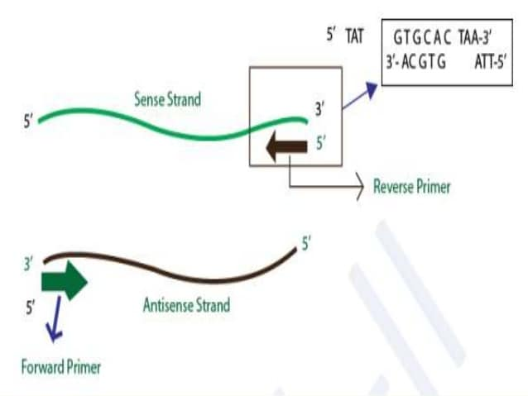

Slide 5
Primers: Primers are synthetic DNA strands of about 18 to 25 nucleotides complementary to 3’ end of the template strand. DNA polymerase starts synthesizing new DNA from the 3’ end of the primer .
Two primers must be designed for PCR; the forward primer and the reverse primer. The forward primer is complimentary to the 3’ end of antisense strand (3’-5’) and the reverse primer is complimentary to the 3’ end of sense strand (5’-3’).
Complementary nucleotide sequences within a primer and between primers should be avoided. If there are complimentary sequences in two primers used (one primer for each DNA strand), the primers will hybridize with each other thus forming primer-dimmers and will not be available for binding with template. If there are complementary sequences within a primer, it will make hairpin loop structures as shown below

Slide 6
Nucleotides (dNTPs or deoxynucleotide triphosphates): All types of nucleotides are "building blocks" for new DNA strands and essential for reaction. It includes Adenine(A), Guanine(G), Cytosine(C), Thymine(T) or Uracil(U).
Magnesium: Magnesium affects primer annealing and template denaturation, as well as enzyme activity. An excess of magnesium gives non-specific amplification products, while low magnesium yields lesser amount of desired product.

Slide 7
Procedure:
There are three major steps in a PCR, which are repeated for 30 or 40 cycles. This is done on an automated cycler, which can heat and cool the tubes with the reaction mixture in a very short time.
As Adenine and Thymine base pairs with a single H-bond so Thymine (T) or Adenine (A) residues should be avoided at the 3’ end of primers as this weaken the primer’s hold on the template DNA.

Slide 8
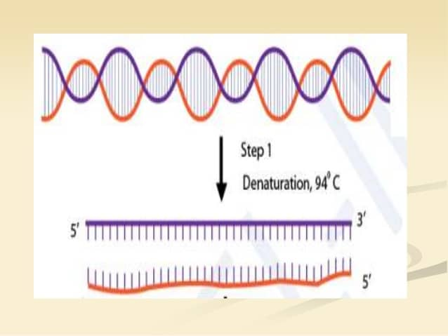
Denaturation at 94°C : During the heating step (denaturation), the reaction mixture is heated to 94°C for 1 min, which causes separation of DNA double stranded. Now, each strand acts as template for synthesis of complimentary strand.

Slide 9
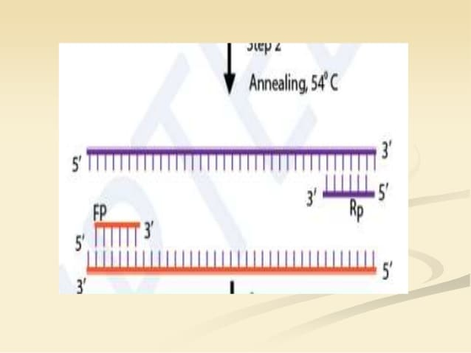
Annealing at 54°C : This step consist of cooling of reaction mixture after denaturation step to 54°C, which causes hybridization (annealing) of primers to separated strand of DNA (template). The length and GC-content (guanine-cytosine content) of the primer should be sufficient for stable binding with template.

Slide 10
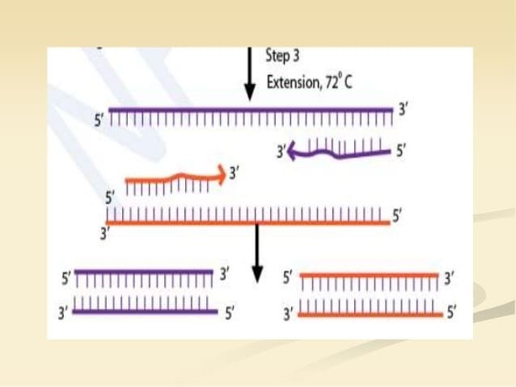
Extension at 72°C : The reaction mixture is heated to 72°C which is the ideal working temperature for the Taq polymerase. The polymerase adds nucleotide (dNTP's) complimentary to template on 3’ –OH of primers thereby extending the new strand.
Final hold: First three steps are repeated 35-40 times to produce millions of exact copies of the target DNA. Once several cycles are completed, during the hold step, 4–15 °C temperature is maintained for short-term storage of the amplified DNA sample.

Slide 11
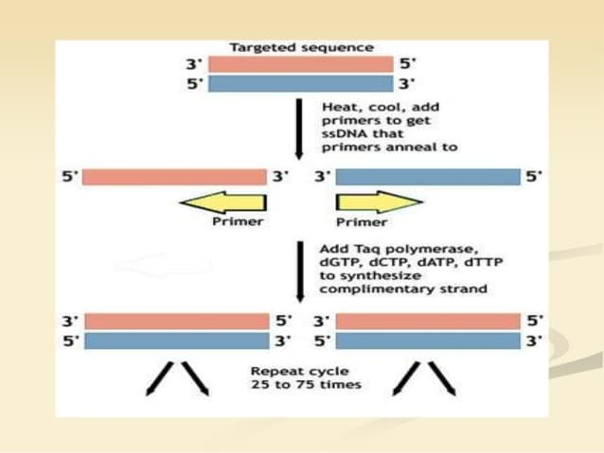

Slide 12
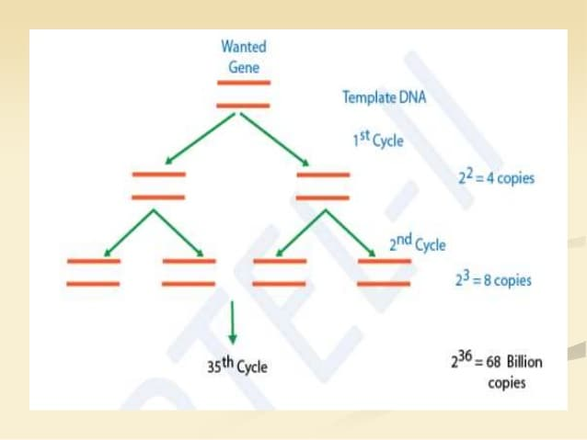
PCR-an exponential cycle: As both strands are copied during PCR, there is an exponential increase of the number of copies of the gene. Suppose there is only one copy of the desired gene before the PCR starts, after one cycle of PCR, there will be 2 copies, after two cycles of PCR, there will be 4 copies. After three cycles there will be 8 copies and so on.
Reaction Condition & Denaturing conditions are best at 94-95°C for 30-60 seconds. Lower temperatures may result in incomplete denaturation of target template and PCR products. Higher temperatures and a longer amount of time can lead to enzyme activity loss.

Slide 14
Applications
Used in molecular biology and genetic disease research to identify new genes; for example, the sample containing pathogenic DNA can be PCR amplified using different known specific primers. The amplification indicates presence of pathogenic DNA.
In fields such as anthropology and evolution, sequences of degraded ancient DNAs can be tracked after PCR amplification. With its exquisite sensitivity and high selectivity, PCR has been used for wartime human identification and validated in crime labs for mixed-sample forensic casework.
PCR permits early diagnosis of malignant diseases such as leukemia and lymphomas. PCR assays can be performed directly on genomic DNA samples to detect translocation specific malignant cells, infectious agents, like mycobacterium, anaerobic bacteria, or viruses.

Slide 15
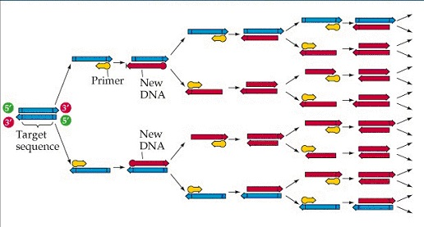
Steps involve in PCR
Initialization step (94-96ºc for 1-9 minutes)
Denaturation step (94-98ºc for 20-30 sec.)
Annealing step (50-60ºc for 20-40 sec.)
Extension step (72-75ºc )

Slide 16
Basic needs in PCR
DNA template
Primers
Taq polymerase (Thermus aquaticus)
dNTPs (Deoxyucleotide triphosphat )
Buffer
Divalent cation
Applications of PCR
Parental testing
Detection of Oncogenes
DNA cloning for sequencing
To identification of genetics fingerprinting
Characterization and detection of infectious diseases, and more….

